Slide 1

Deep Learning

Slide 2
Deep Learning

Slide 3
Deep Neural Network

Slide 4
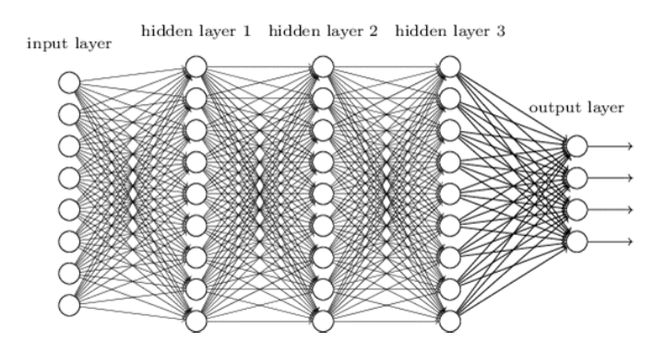
Deep Neural Network
input layer
output layer
hidden layer 1
hidden layer 2
hidden layer 3

Slide 5








Slide 6


Slide 7




Slide 8






Slide 9






Slide 10







Slide 11




Slide 12





Slide 13





Slide 14
Deep Learning

Slide 15










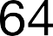





Slide 16

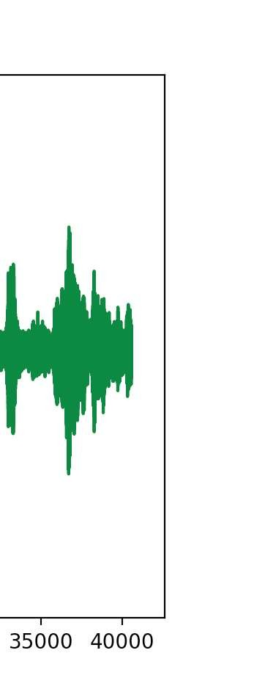

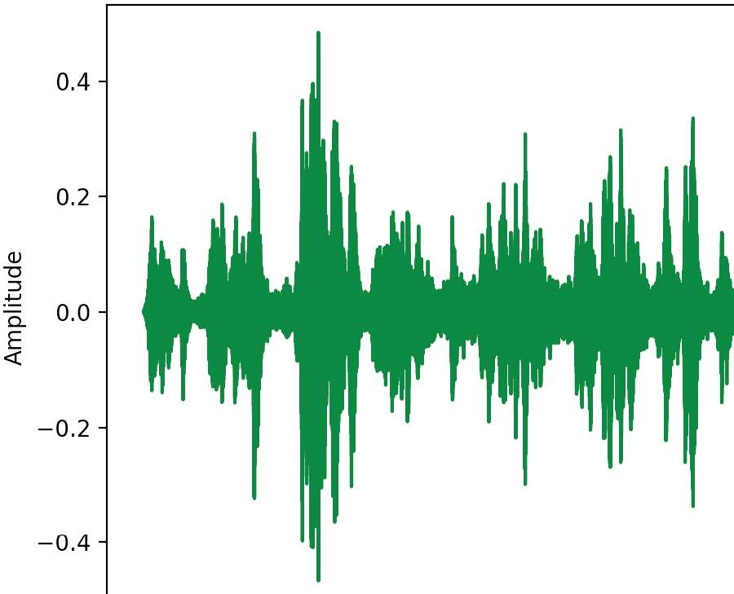
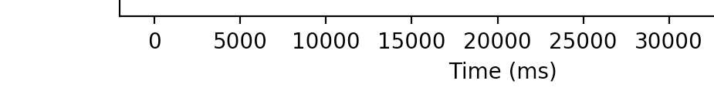




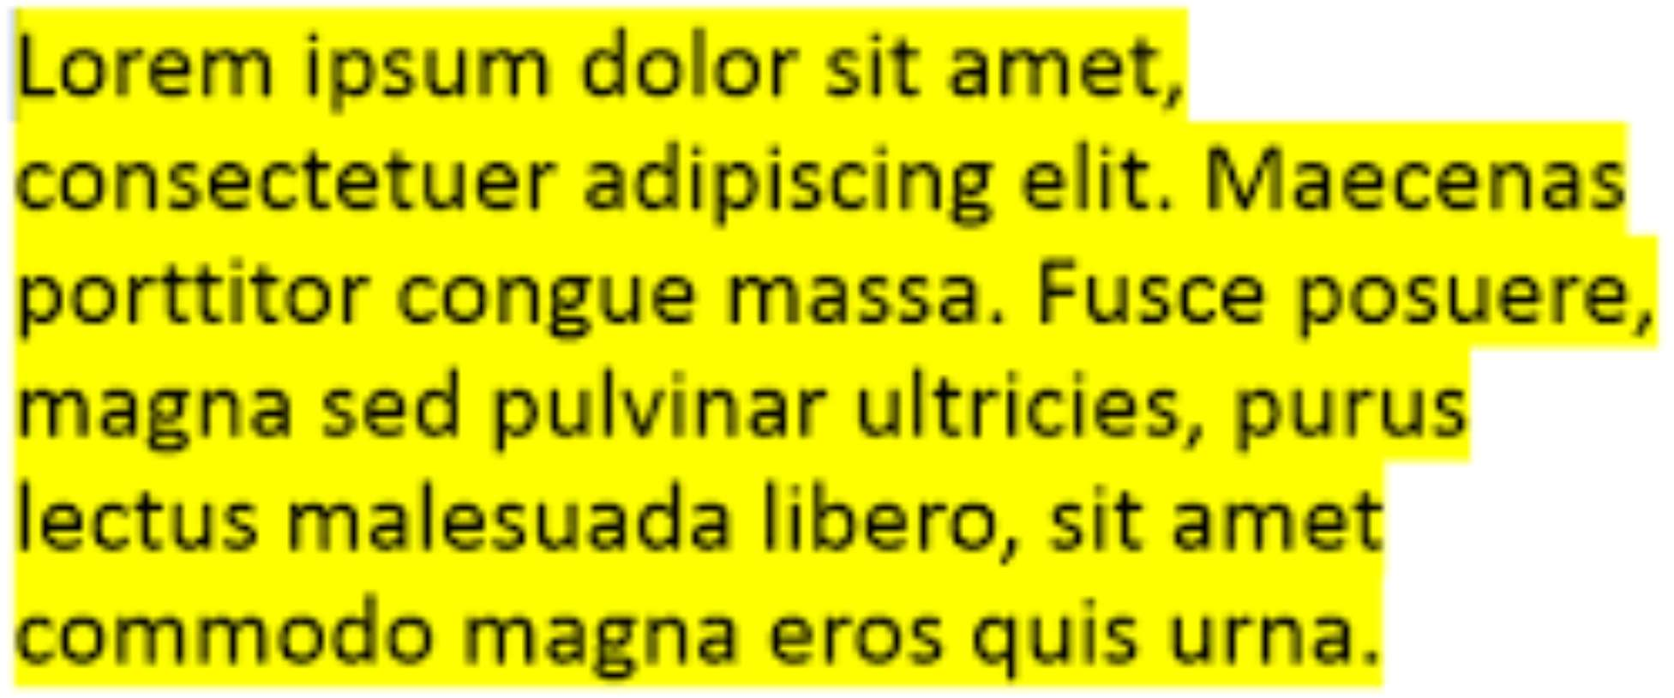



Slide 17
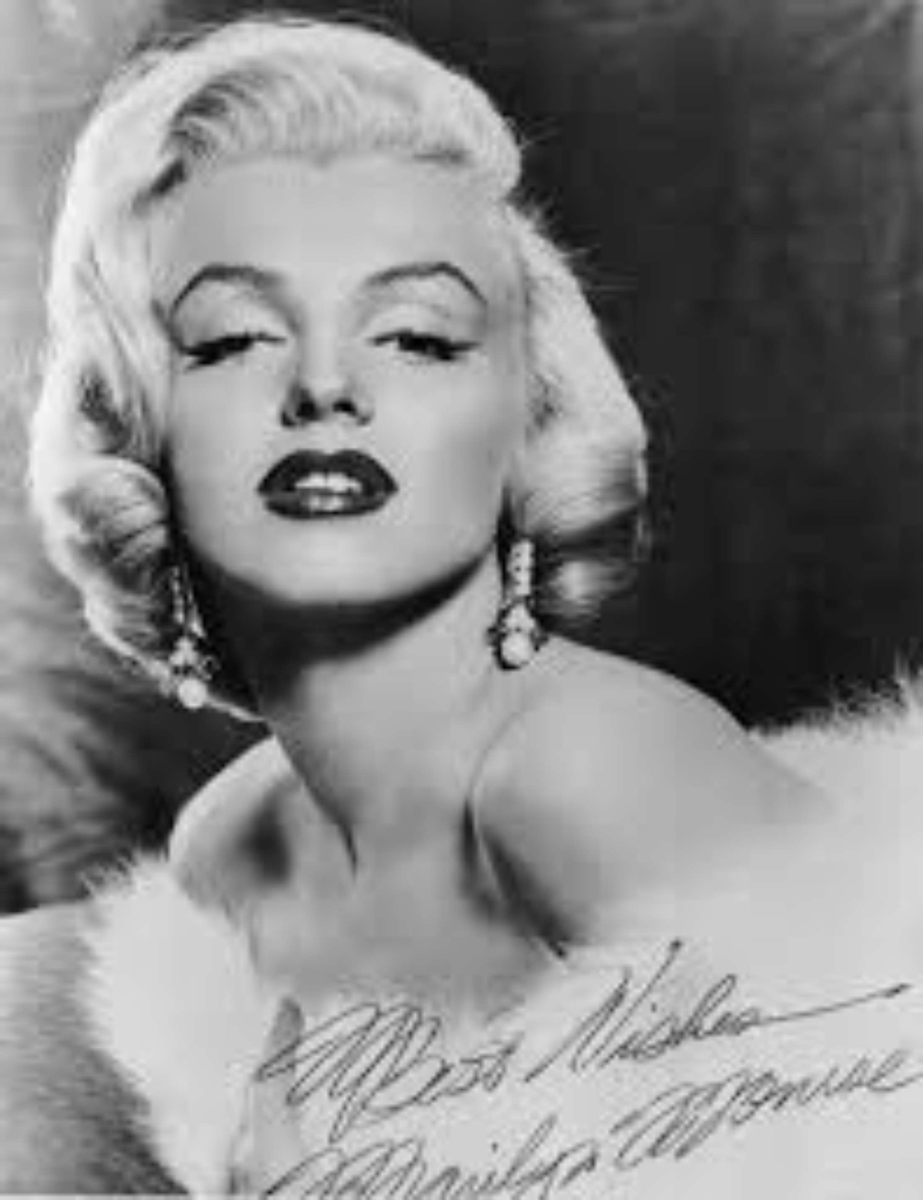

Slide 18


Slide 19
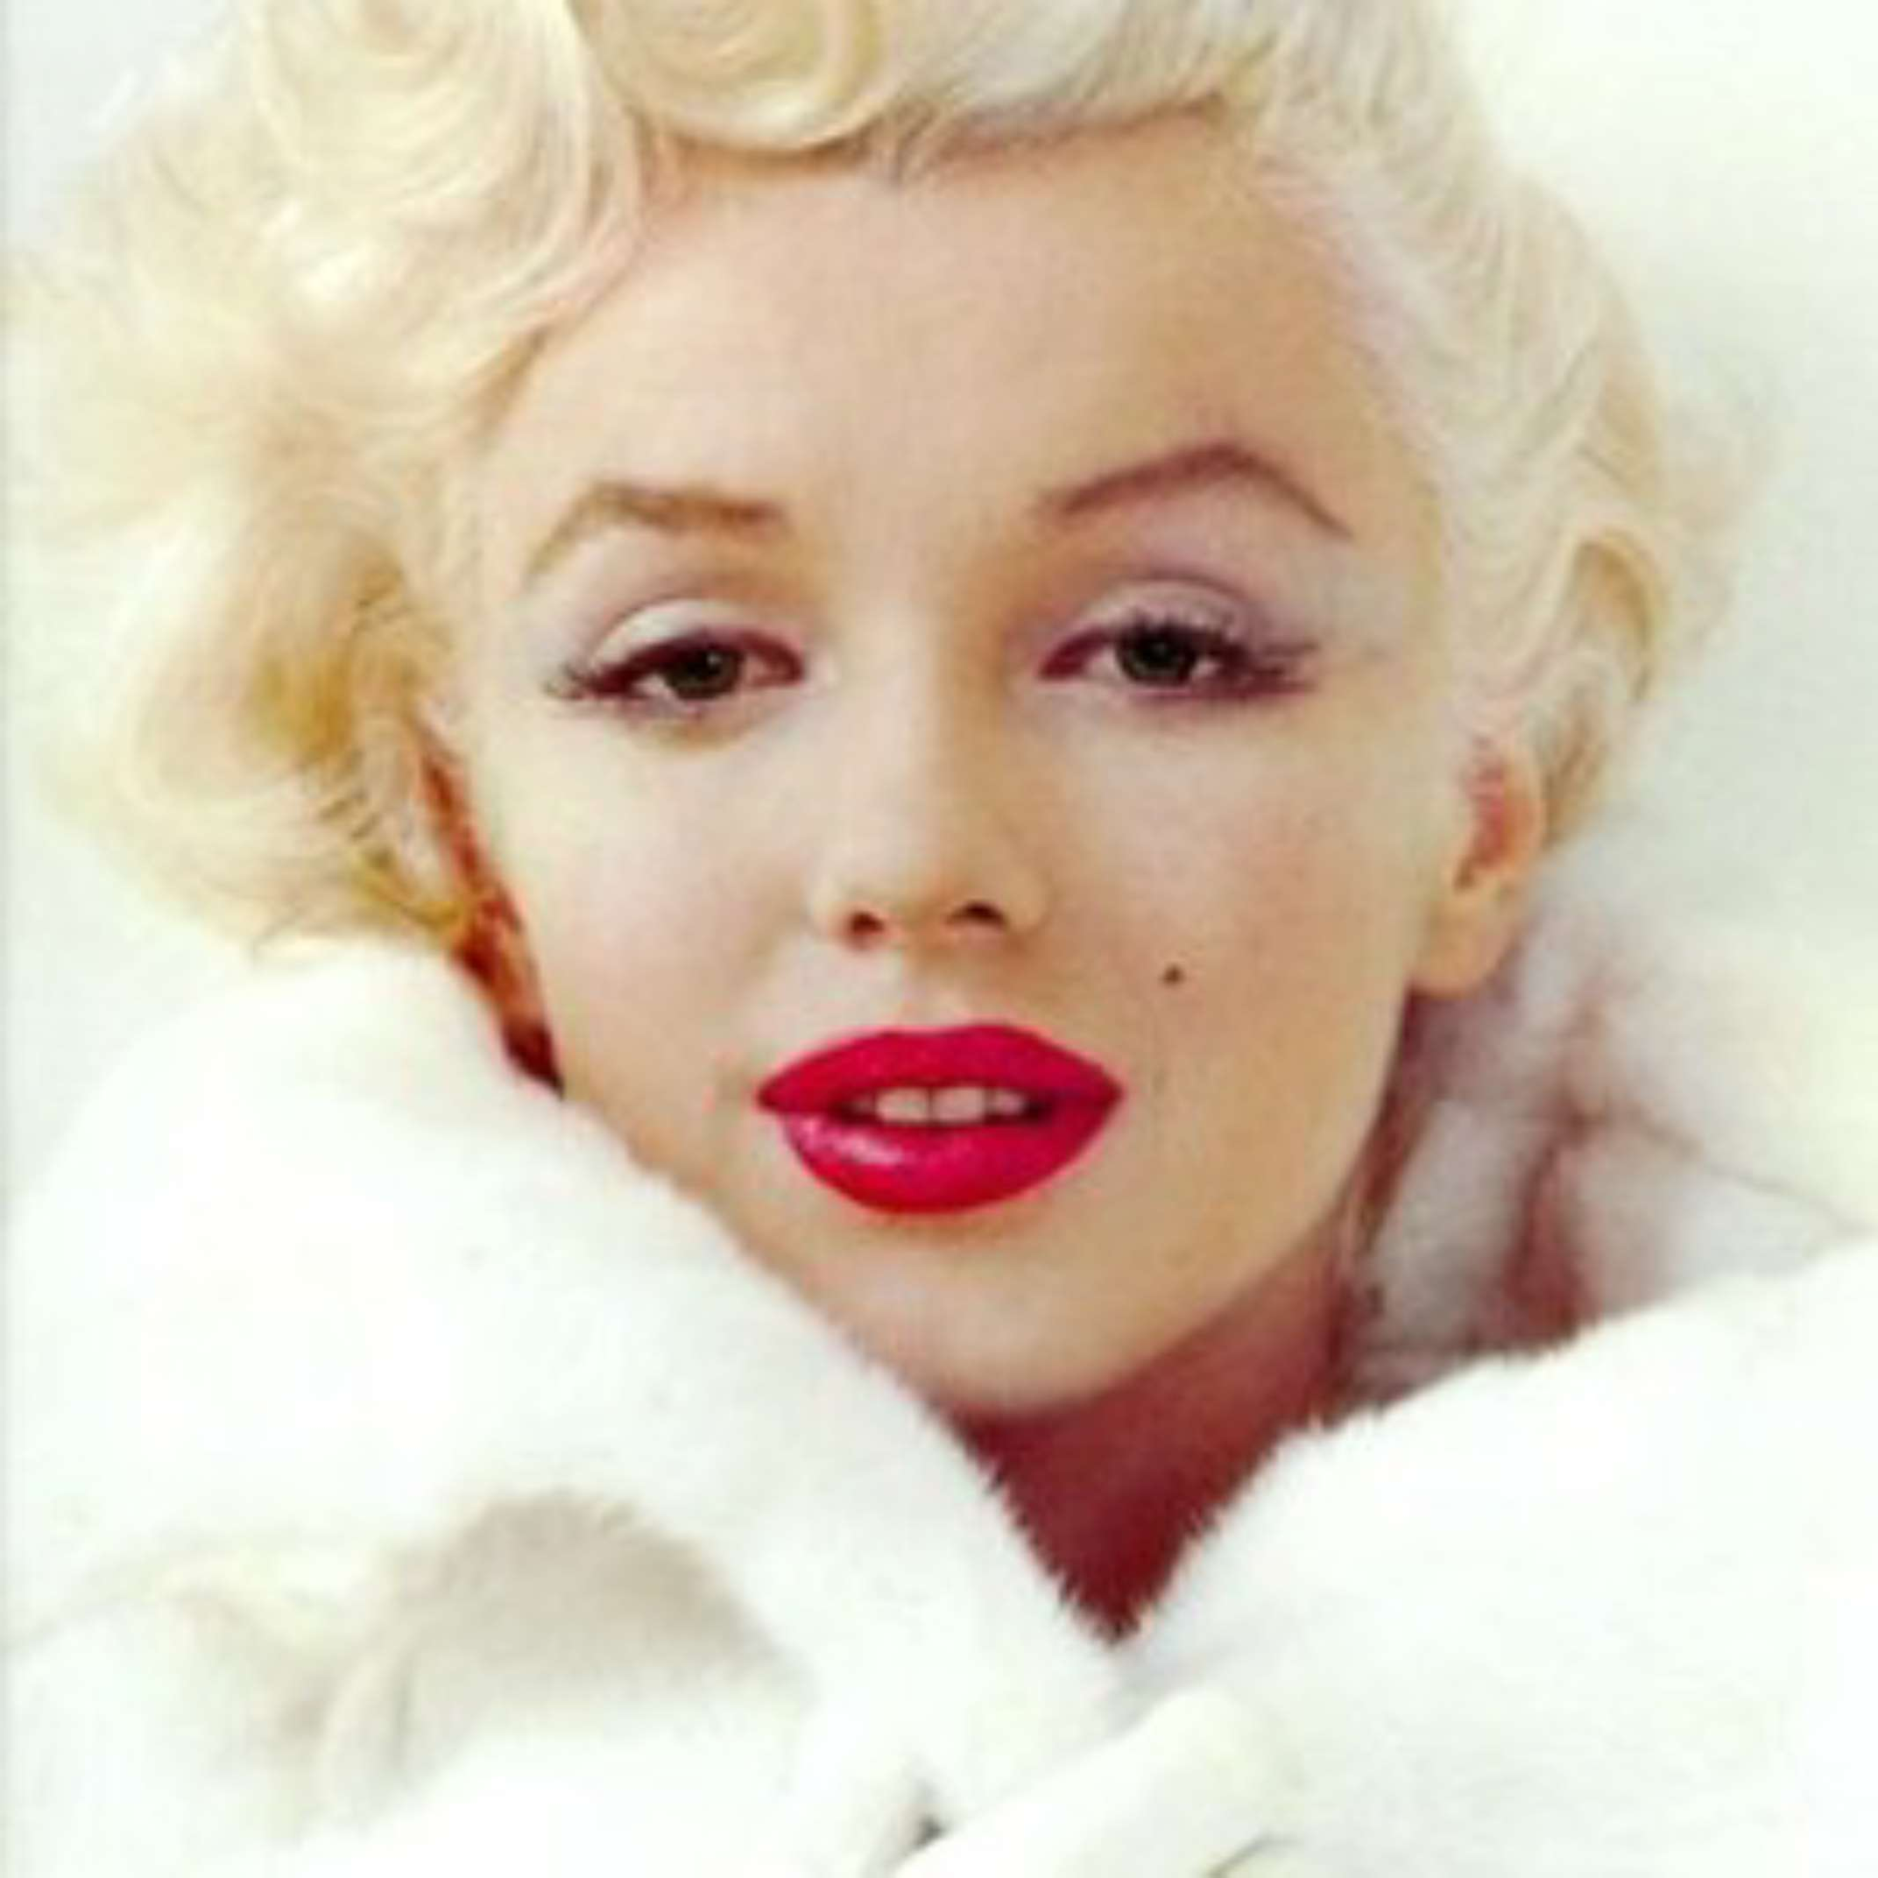

Slide 20
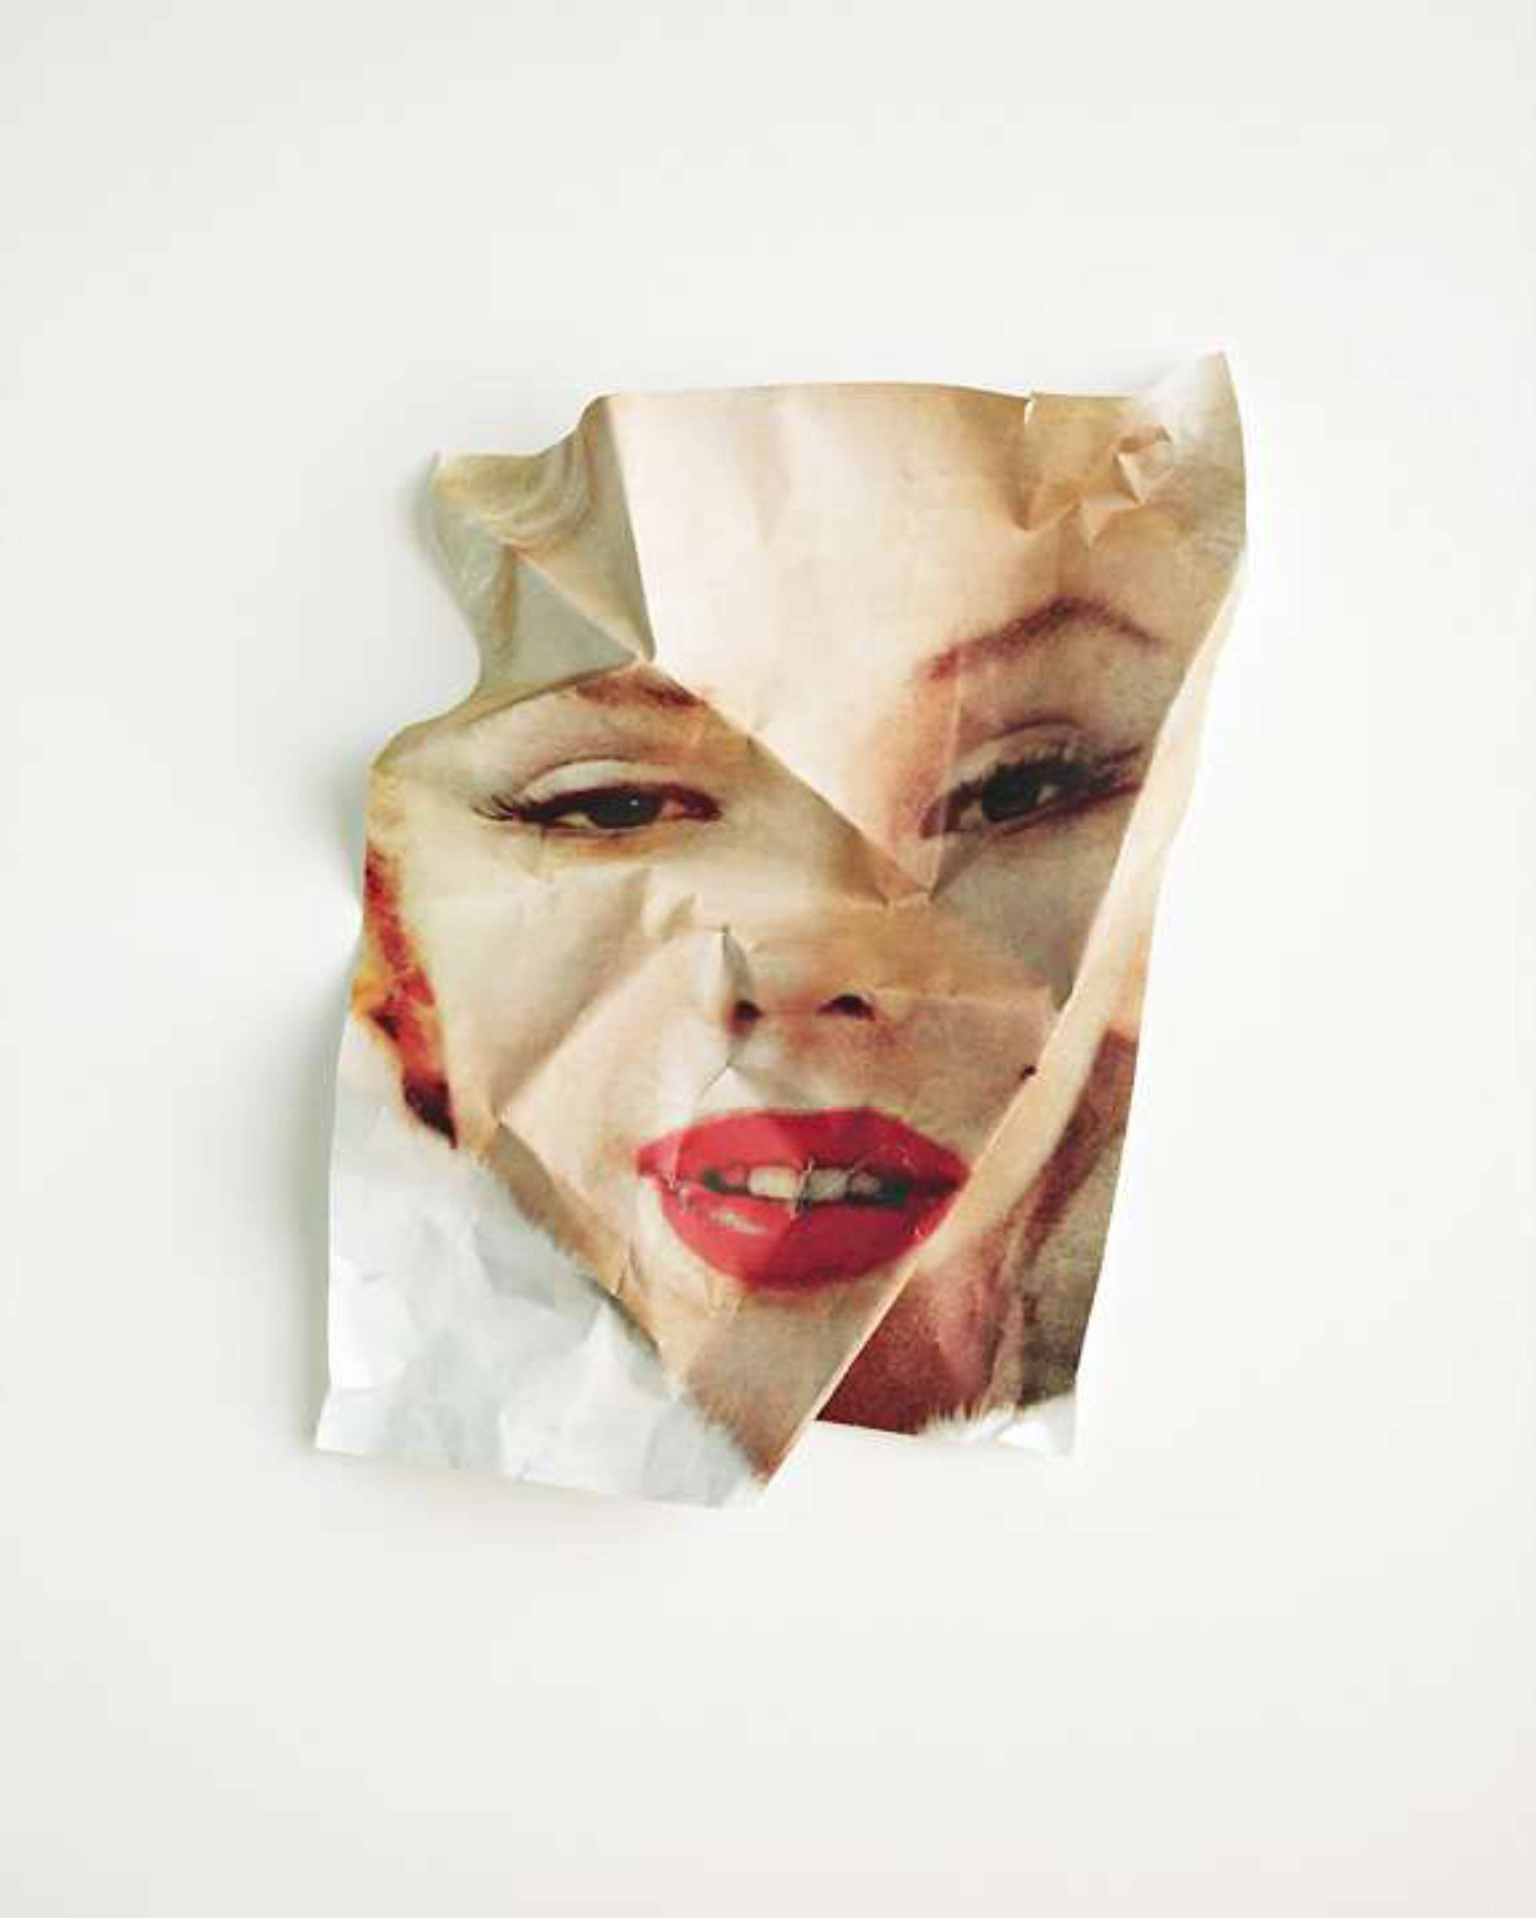

Slide 21
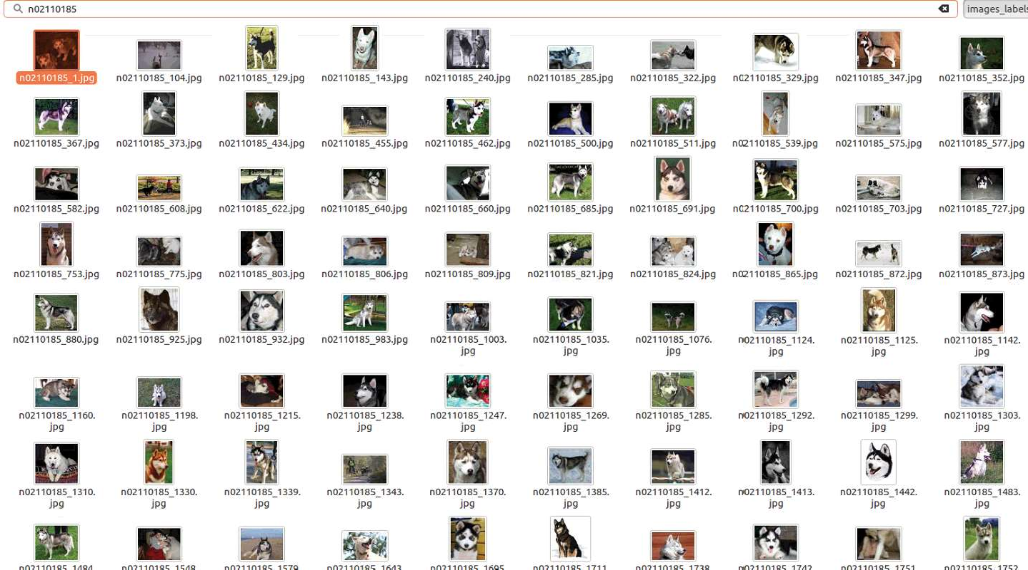

Slide 22
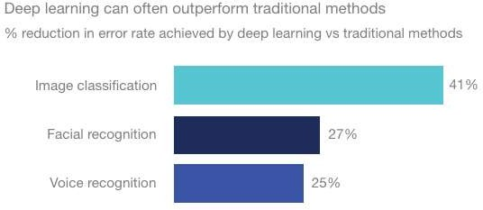




Slide 23





















Slide 25


Slide 26
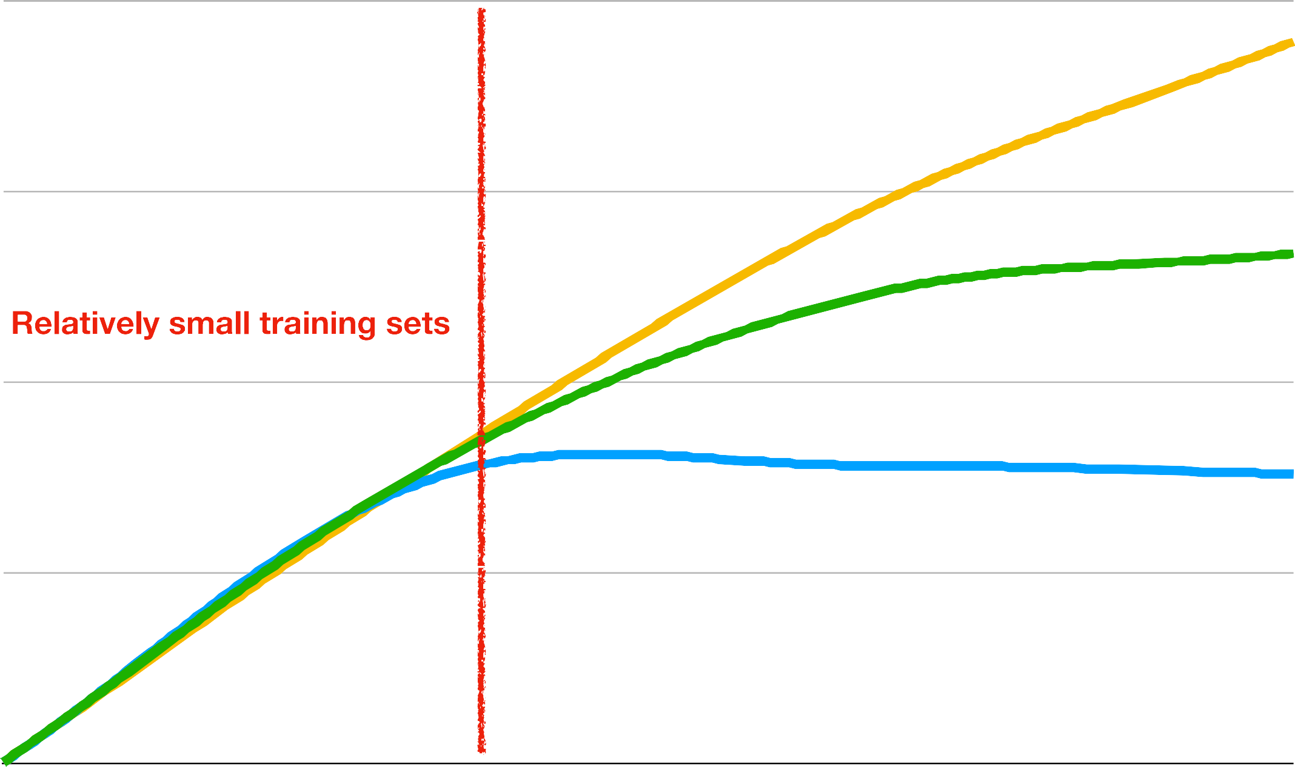




Slide 28

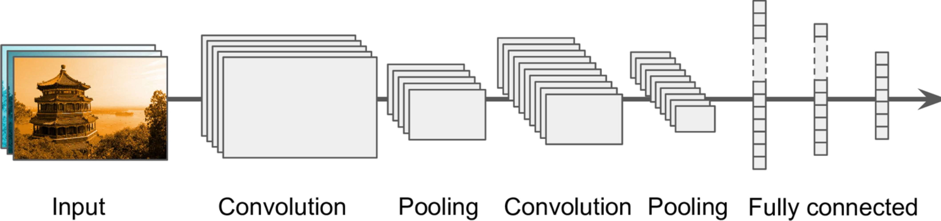

Slide 29
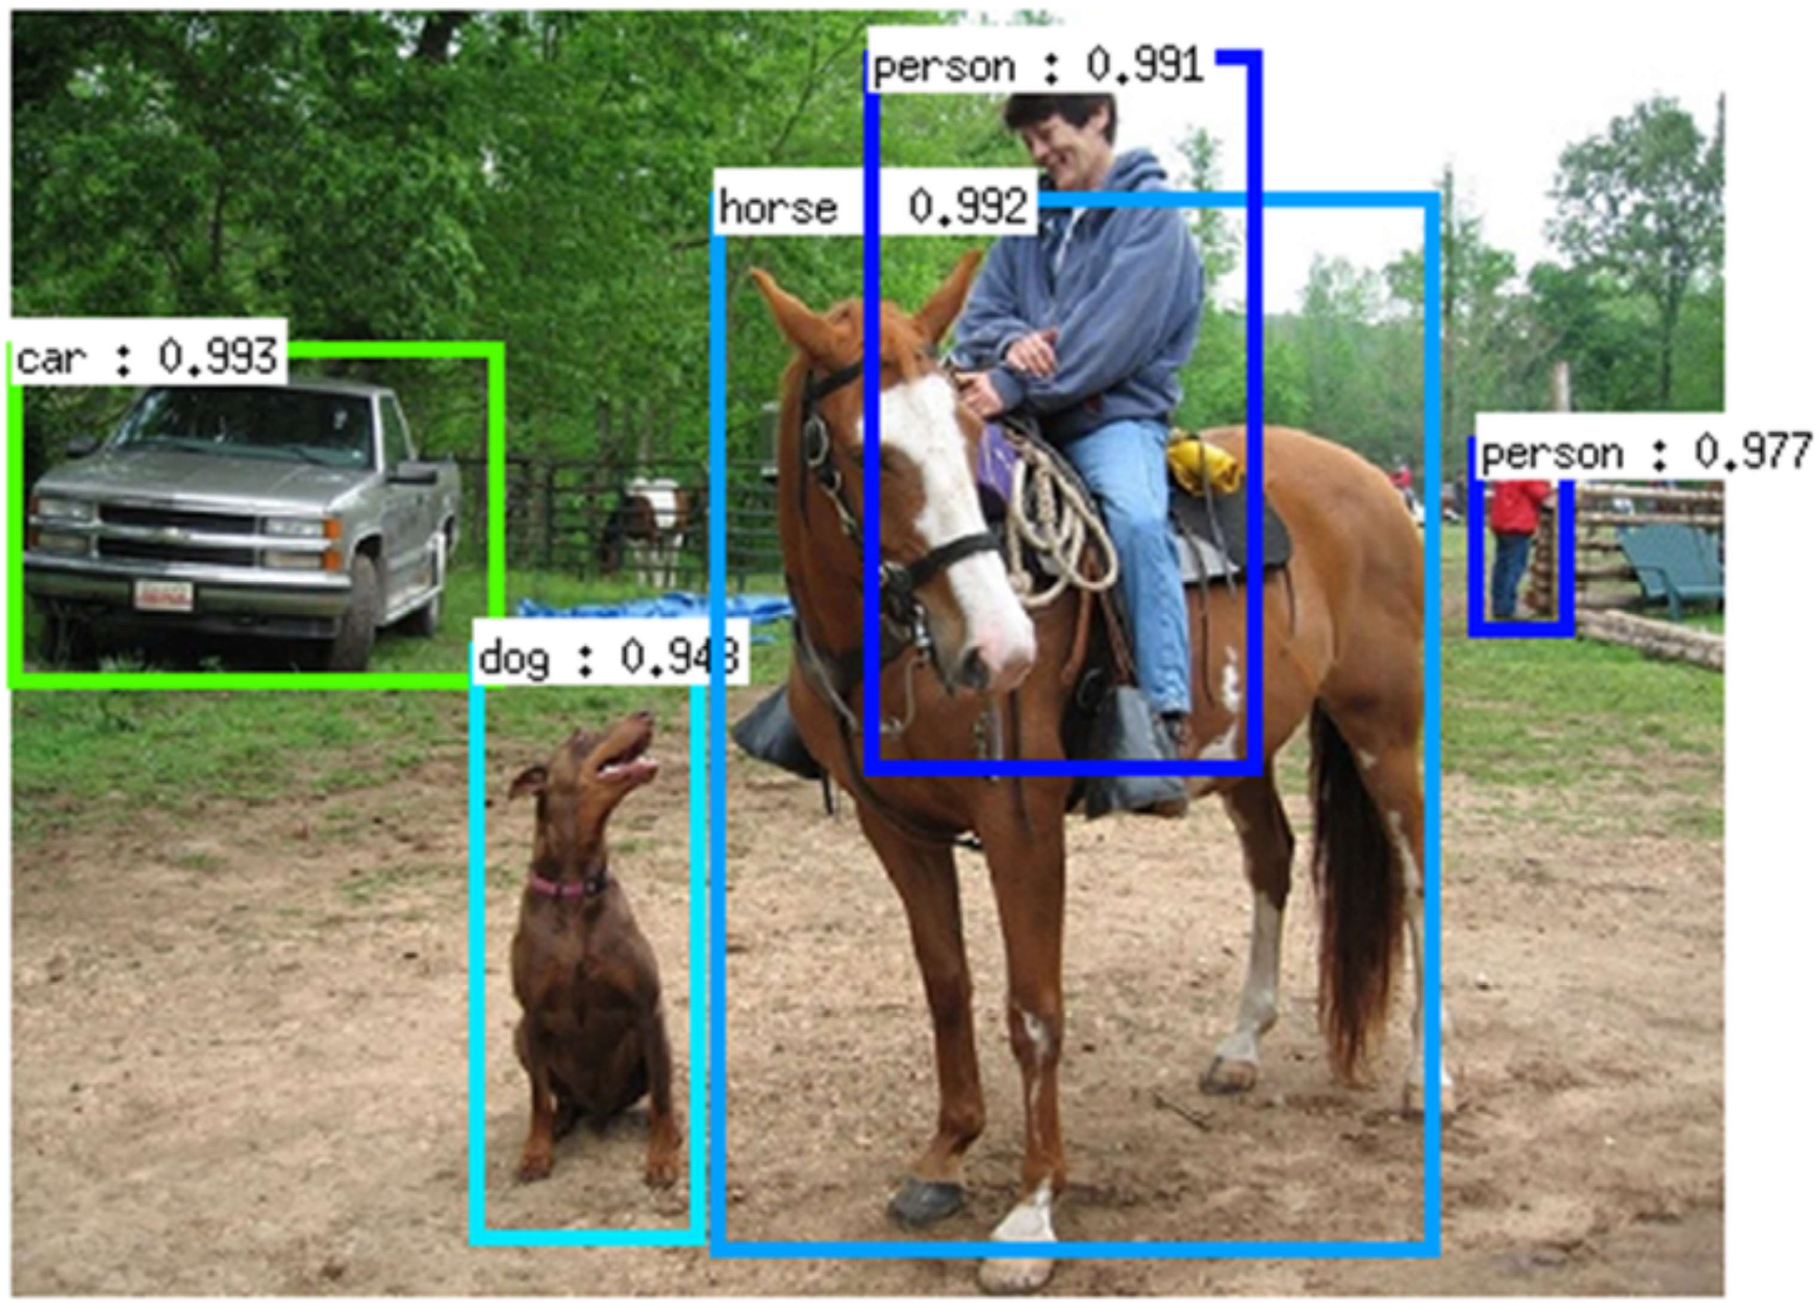

Slide 30


Slide 34
WIDTH

Slide 35
HEIGHT
WIDTH

Slide 36
HEIGHT
WIDTH
DEPTH

Slide 47
Feature Map

Slide 48


Slide 49
Feature Map

